Slide 1
Supervised learning
此次PPT为之前基础的补充与扩展

Slide 2

Linear Regression
Why?

Slide 3

Probabilistic interpretation

Slide 4
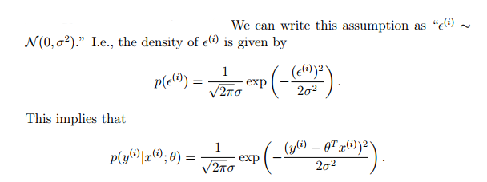

Slide 5
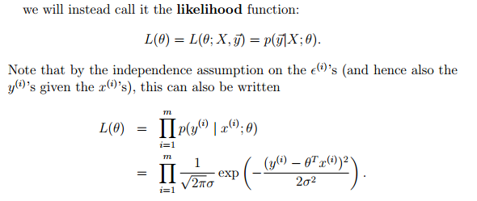

Slide 6
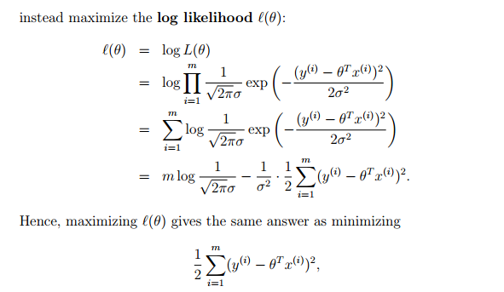

Slide 7
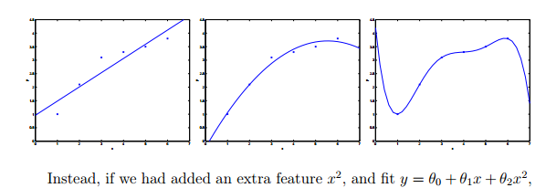
Locally weighted linear regression

Slide 8
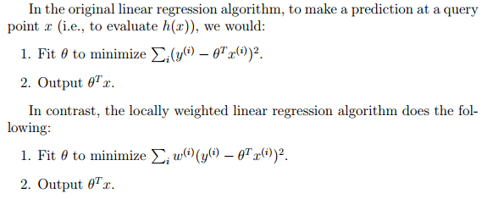

Slide 9


Slide 10
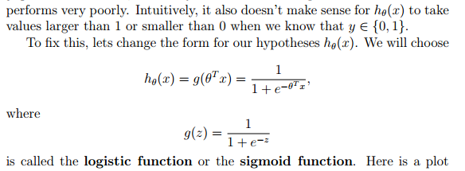
Classification and logistic regression

Slide 11
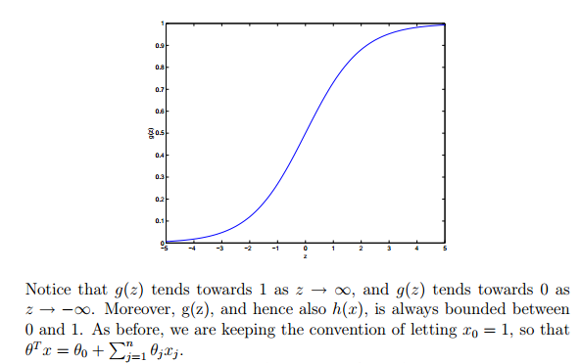

Slide 12


Slide 13
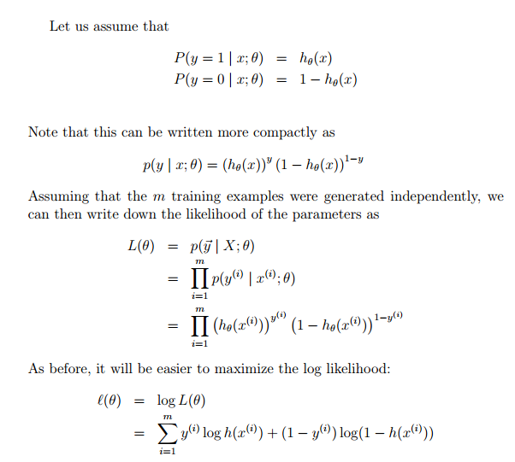

Slide 14

Stochastic gradient ascent rule

Slide 15

The perceptron learning algorithm

